Slide 1
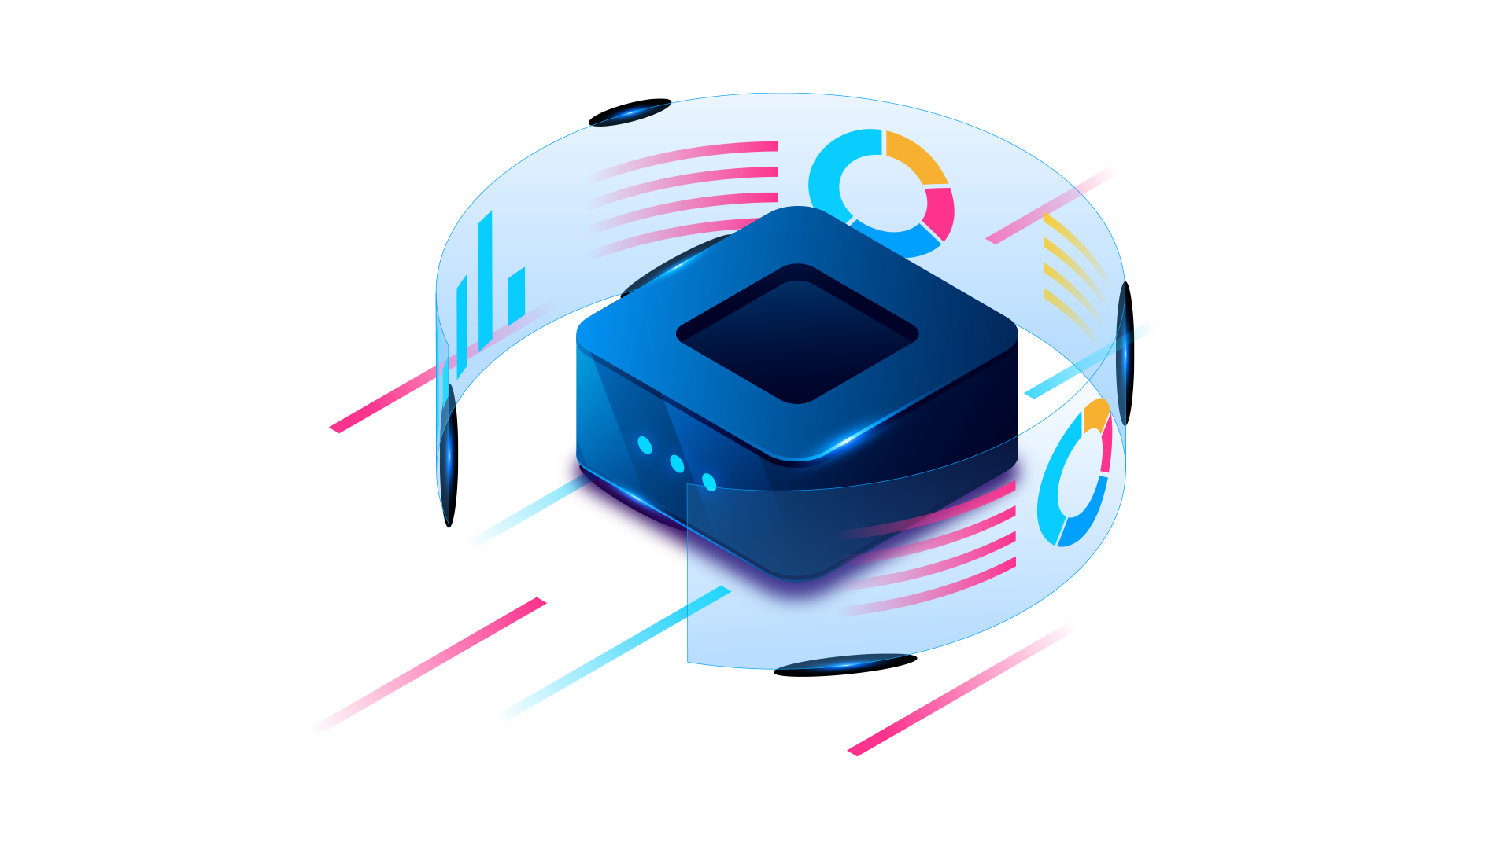
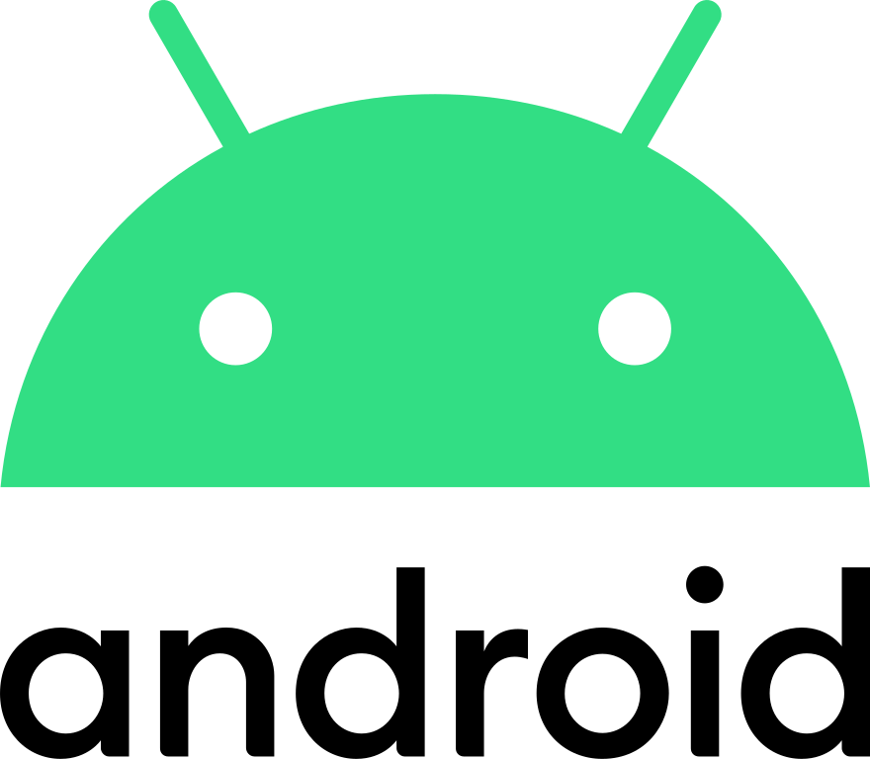
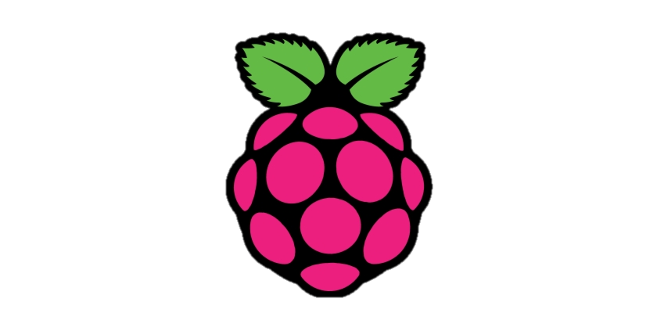
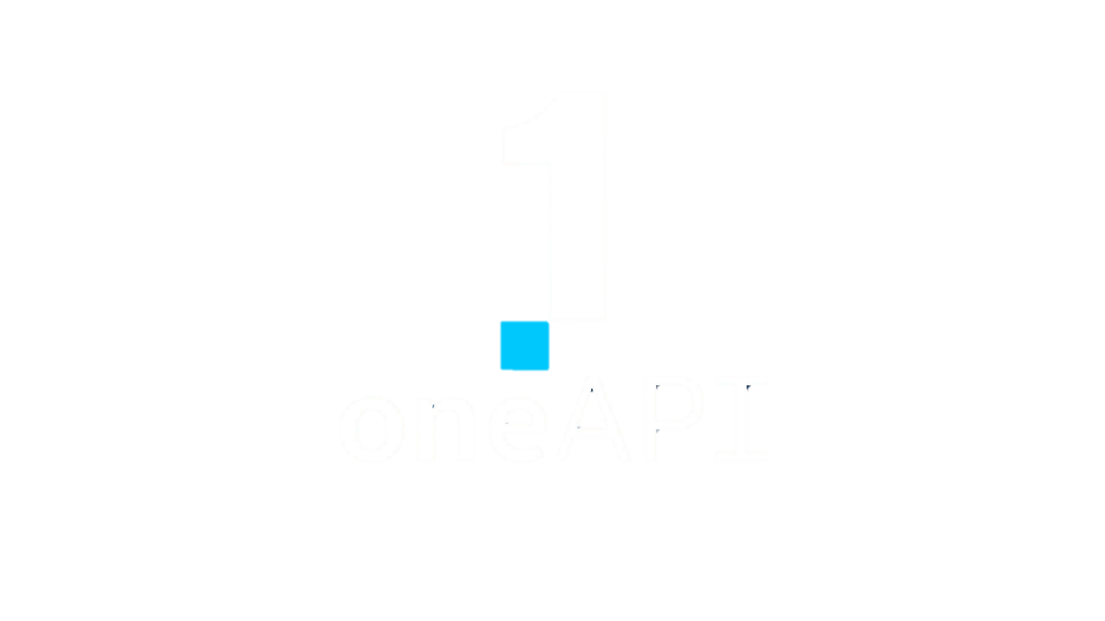
INTEL HACKATHON
SMART BELT
WITH ANDROID ACCESS USING RASPBERRY PI | INTEL ONE API
For The treatment of LUMBAR SPONDYLOSIS &
ALL COMMON BACK AND SPINAL PROBLEMS

Slide 2
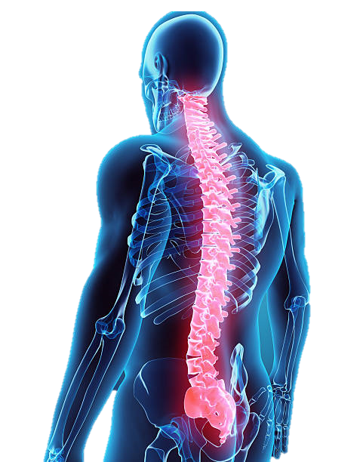
PROBLEM STATEMENT
Although there are treatments for spondylosis, stenosis, and other types of lumbar spinal abnormalities, they can be expensive, must be utilized only when the condition is too severe, and even then, the treatment is useless as the issue gets worse. The only way to stop this is to have a doctor remotely help you while the issue is still manageable and prevent it from getting worse.
FACTORS TO CONSIDER INTO ACCOUNT
Age
Stage of disease
Physician convenience
Patient convenience
Accessibility(user-friendliness)
Cost
Why is it better than present solution?

Slide 3
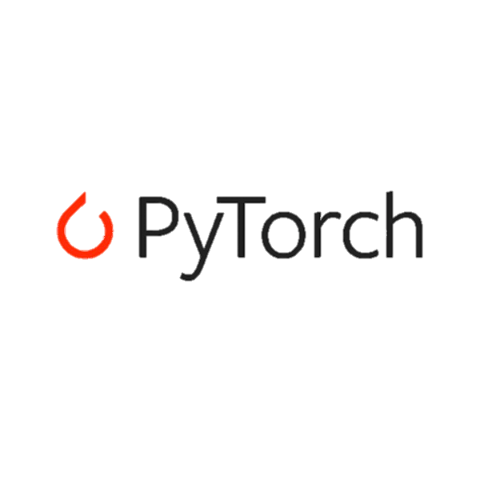
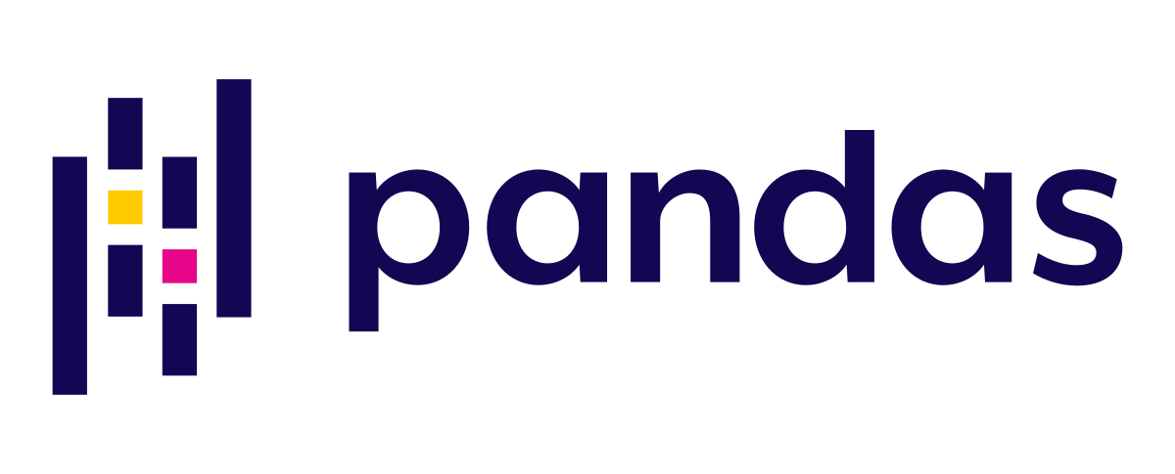
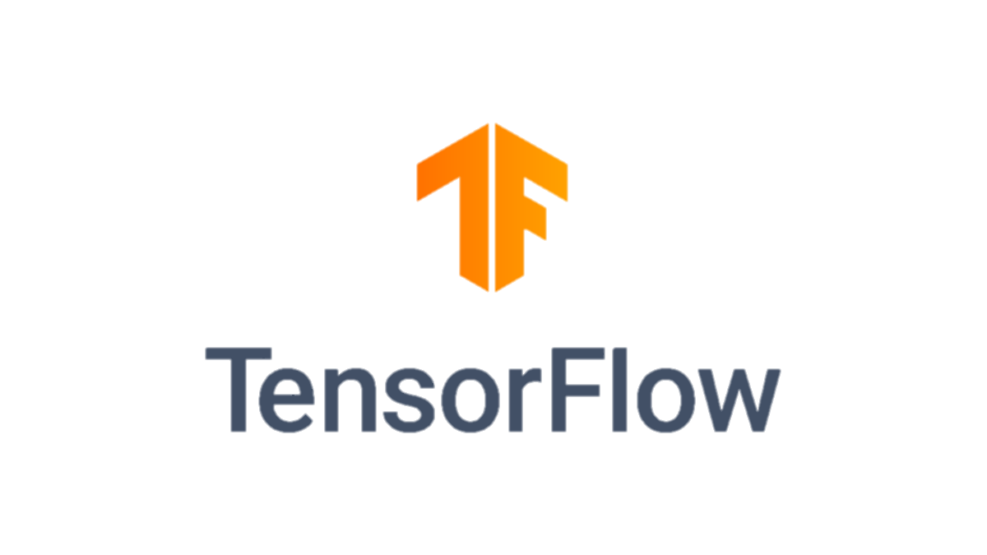
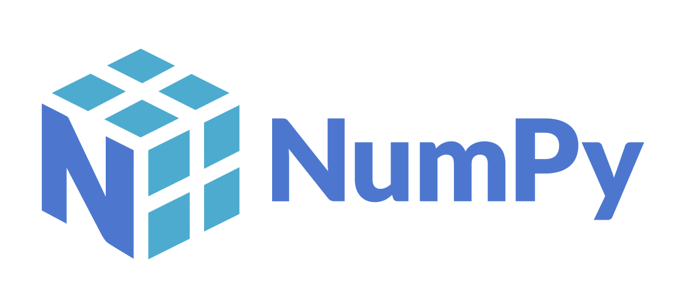
SOLUTION STATEMENT
We have developed a solution using machine learning algorithms, IOT and AI via Intel ONEAPI
We have developed a wearable belt that will enable real-time monitoring of the patient's spinal activity, including his movements. This information will be collected, analysed, and sent to the doctor, the patient, and any family members via an Android or iOS app, It shows information of the bend angle,strain,and pressure exerted. suggest particular workouts and stretching regimens to help and treat their condition. By continually monitoring and providing feedback which can assist in preventing further damage to the spine and supporting healing and recovery.
The vibrations or electric impulses transmitted to the spines by devices placed into the belt can be used if the patient has been experiencing severe pain and movement imbalances. Which acts like a therapy.

Slide 4
HOW IT WORKS
To Android Device
For Processing
Sensors
(Flex sensor)
Collects data from flex sensor
Vibration/
Electrical
Impulses
Process using OneApi
toolkits inside android app
Vibrations for therapy can be stimulated from the app

Slide 5
HOW TO USE
Wear the belt on your back as any other physiotherapy belt.
The doctor will determine the guidelines for physical activities like bending, walking pressure, etc., as well as the exercises and treatment.
The entire patient's backbone and spinal data will be collected in real-time and transmitted to the mobile application for processing.
The patient, patient's relative and the doctor will both utilize the smartphone app, although their individual roles may vary.
Depending on their condition, the app will recommend treatments.Using a smartphone app, the patient may transmit vibrations or electric impulses to their back.

Slide 6
IntelOne API Concepts Integrated
Distributed python toolkit from Intel AI Analytics toolkit(used) or Intel One API basic toolkit
Analyse patterns and datas from sensors and process it using different python libraries Numpy and pandas
Use Math Kernel Library Function to do the mathematical calculations like average,angle,radian etc.

Slide 7
KEY FEATURES
Modern AI Analytical Technologies used
Healthcare
Accurate Results using AI
USER FRIENDLINESS
MULTI CODE ARCHITECTURE
Innovation
IOT-AI-ML-DATA
(Connecting many codes to one)

Slide 8
DEVELOPMENT STAGES
INTIAL
MIDDLE
FINAL
Analysis and processingof data Using OneApI AI analytics Toolkit
Reading Data From flex sensors connected to raspberry pi ,and processing it using Math kernal library
Mobile app where we can view control and customise numerous things from functions and therapies to doctor advices,

Slide 9
PROJECT TIMELINE
LAUNCH
TESTING AND VALIDATION
RESEARCH
DEVELOPMENT
02
INTEGRATION AND
SOFTWARE DEVELOPMENT:
04
01
03

Slide 10
Research and Development:
This phase will entail creating a prototype for the smart belt and looking into current gadgets and technologies that can detect spinal motions. To better understand the requirements of people with spinal disorders, the research will entail examining academic material and conducting interviews with medical experts.
Testing and Validation:
The prototype will be tested to ensure that it accurately detects spinal movements and is reliable. The tests will include laboratory experiments and clinical trials with patients suffering from spinal illnesses. The tests will be conducted with a variety of patients to ensure that the device works for a wide range of individuals.
Integration and Software Development:
The vibrating medium and software will be integrated into the final product, and software will be developed to process the data received from the device. The vibrating medium will alert patients to avoid back movements that may exacerbate their condition. The software will be designed to process the data in real-time and send alerts to the patient and their doctor when necessary.

Slide 11
User Interface Design:
A user-friendly interface will be designed for patients and doctors to access the data collected by the device. The interface will be easy to use and will provide patients with clear information about their spinal movements. The interface will also enable doctors to set parameters for the device, such as the maximum allowable bending angle for a patient
Final Testing and Validation:
The final product will undergo testing and validation to ensure that it meets the project objectives. The testing will include laboratory experiments and clinical trials with patients suffering from spinal illnesses. The testing will be conducted with a variety of patients to ensure that the device works for a wide range of individuals.The prototype will be tested to ensure that it accurately detects spinal movements and is reliable. The tests will include laboratory experiments and clinical trials with patients suffering from spinal illnesses. The tests will be conducted with a variety of patients to ensure that the device works for a wide range of individuals.

Slide 12
Team DEBUG THUGS
Anvin Shaiju
Jordan Mc
Manu P Jose
Shaik Nabeel
Ashwini

Slide 13
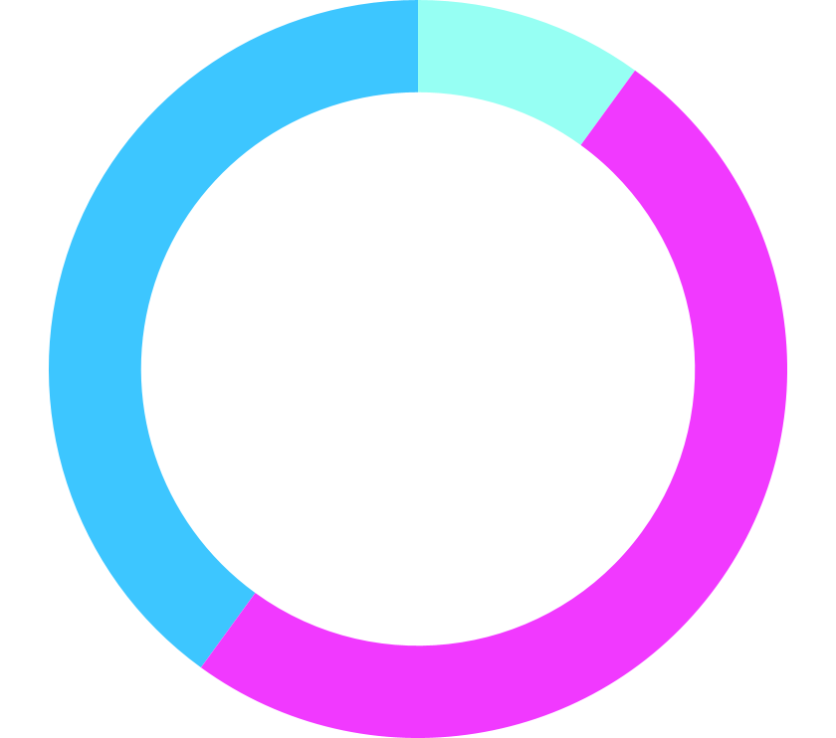
PROJECT PERFORMANCE
10%
SPEED
40%
EFFICIENCY
50%
PREDICTION

Slide 14
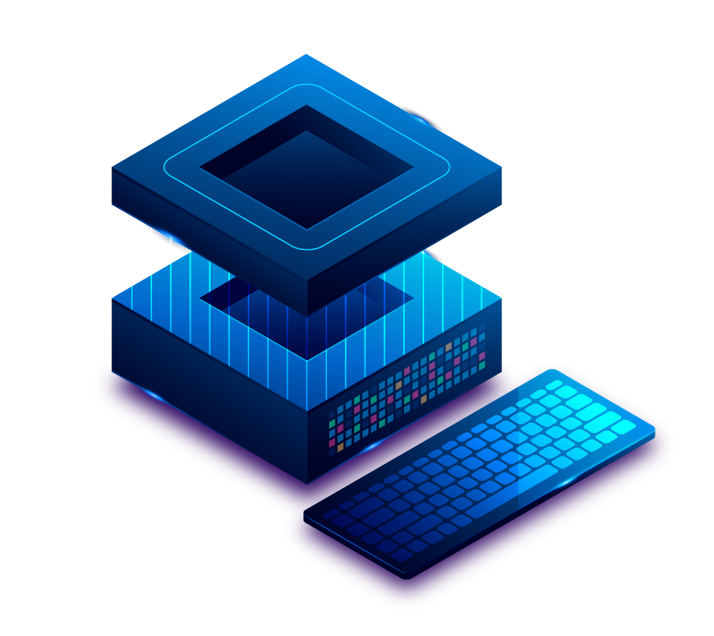
CONCLUSION
In conclusion, a notable advancement in healthcare technology can be seen in the smart belt technology, which combines IntelOneApi IoT and Intel OneAPi AI analytics to monitor spinal activity, communicate data to an Android app, and deliver therapy through vibrations and impulses The smart belt can offer insights on a person's posture and movements, which might affect their general health and wellness, by tracking spinal activity. The use of IoT technology also makes it possible for data to be collected and transmitted in an efficient manner to an Android app, where it may be remotely examined by medical specialists or the wearer themselves. A useful addition to the smart belt's capabilities is its capacity to deliver treatment through vibrations and impulses. This feature can help users achieve better overall health outcomes by supporting muscle training and rehabilitation. In general, smart belt technology has the ability to enhance people's health and wellbeing by encouraging good behaviors and offering insightful data about how the body works. We may anticipate major gains in patient quality of life and healthcare outcomes as a result of ongoing technological breakthroughs. By boosting the efficiency of AI analytics and expanding the smart belt's processing power, the integration of Intel One API adds a new layer of capability

Slide 15
MARKET OUTREACH
High Level Makets
Low level Markets

